Slide 1


DEPI Graduation Project
Super Store Sales

Slide 2

PRESENTED BY:
Mohamed Mohamed Elsayed
Eslam Mohamed Abdelmawgod
Mohamed Mahmoud Yousef
Mohamed Hassan Farshoty
Marwa Sayed Saleh

Slide 3


Tools

Slide 4
Agenda
Conclusion & Recommendations
Introduction
Mapping
Dashboards
1
3
5
2
4
6
Data sources
Measures
Reports
Overview

Slide 5
Overview
Super Store Sales
Project Name
Project Type
Dashboard
commerce
Project industry
Project Idea
Indicate sales company
As a Dashboard
System Analysis
Data Source
Dashboard
Reports
Project Outline
Project Size
MLE (Medium and Large Enterprises)
Notes:
<a href="https://www.freepik.com/free-photos-vectors/business">Business vector created by freepik - www.freepik.com</a>

Slide 6

Introduction
A comprehensive analysis of sales performance across different regions, products, and client categories is provided by this Power BI project. Through the use of interactive visualizations and dynamic dashboards, the project gives stakeholders practical insights into how the business is run. The analysis supports strategic business planning by tracking sales growth, identifying revenue drivers, and keeping an eye on customer behavior

Slide 7
Data Sources
The project integrates data from multiple csv files, including:
Sales Transactions: includes date, product ID, customer ID, region, quantity, and sales amount
Customer Information: includes customer demographics and segmentation
Product Details: includes product categories, subcategories, and pricing
Regional Sales Data: includes regional targets and actual performance
Extract – Transform – Load (ETL)
These datasets were cleaned and transformed using Power Query before being modeled in Power BI.

Slide 8
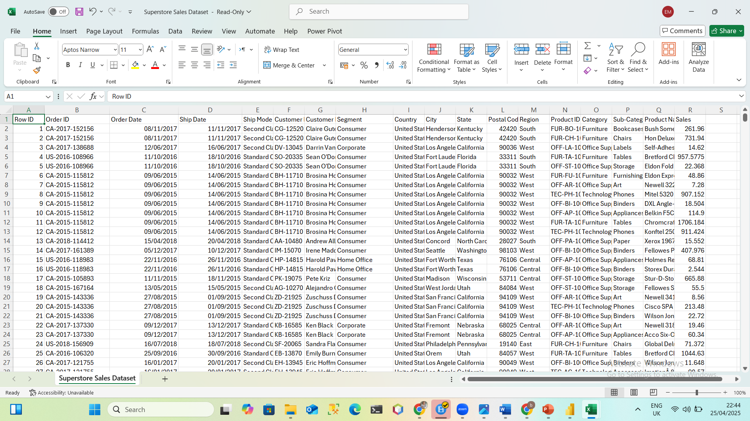
Extract – Transform - Load

Slide 9
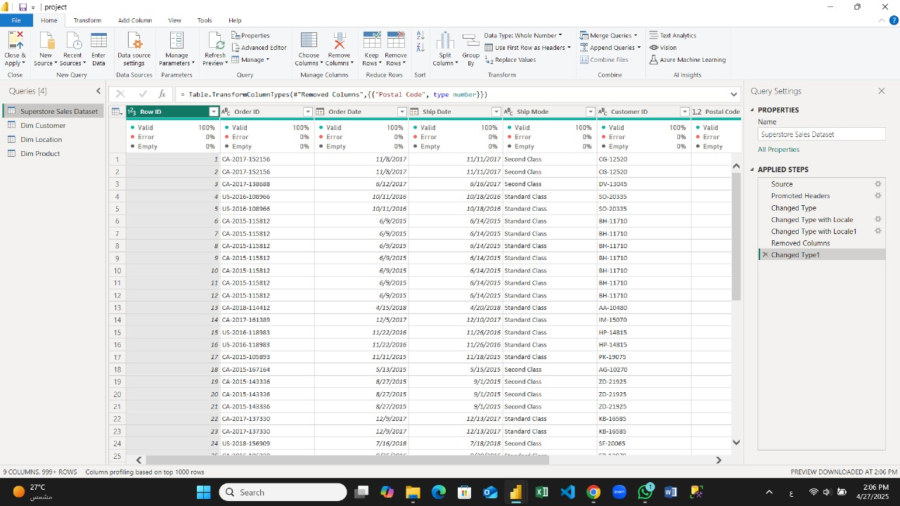
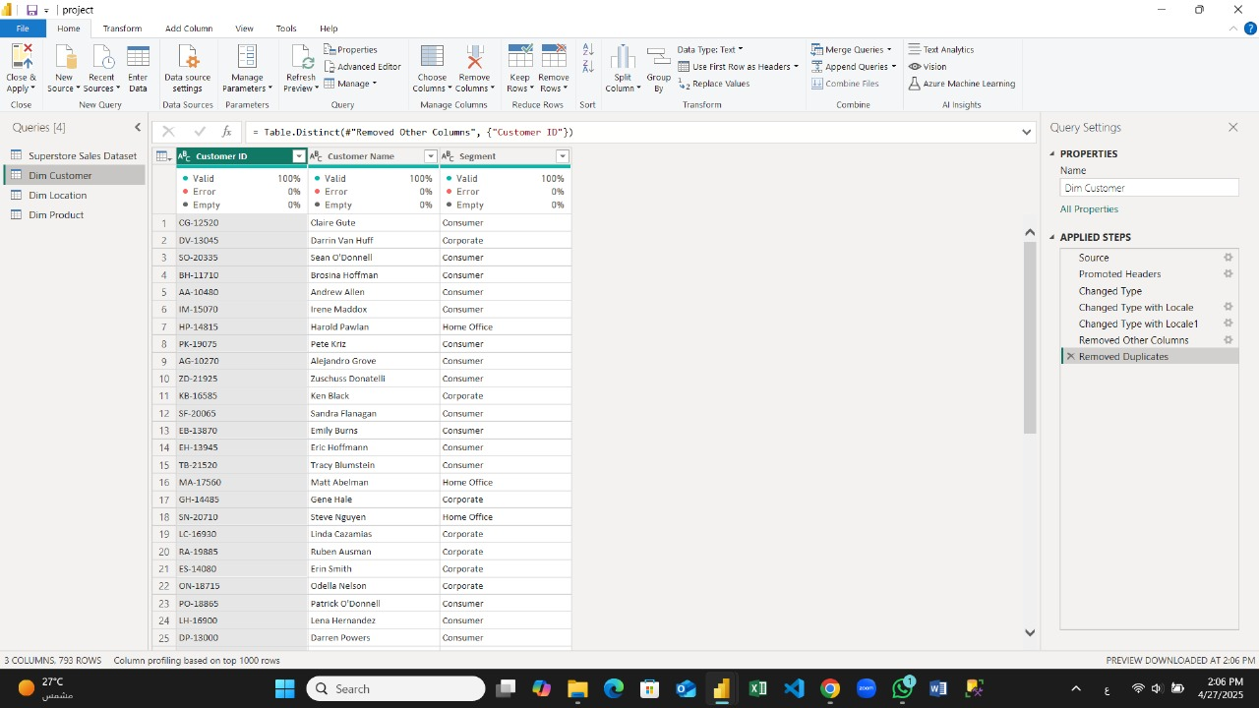
Extract – Transform - Load

Slide 10
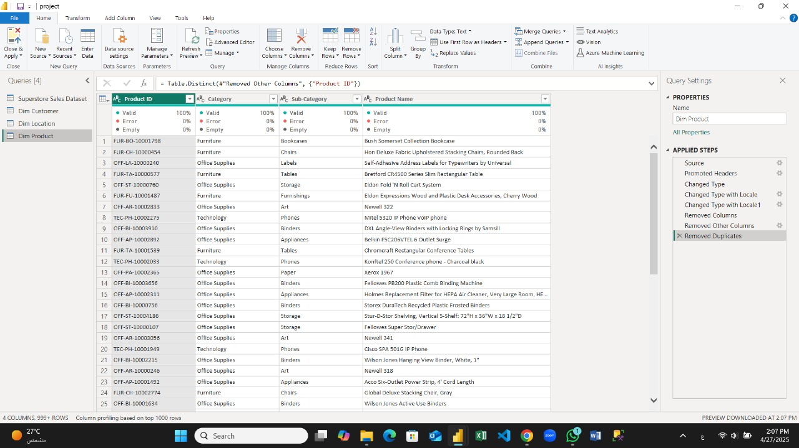
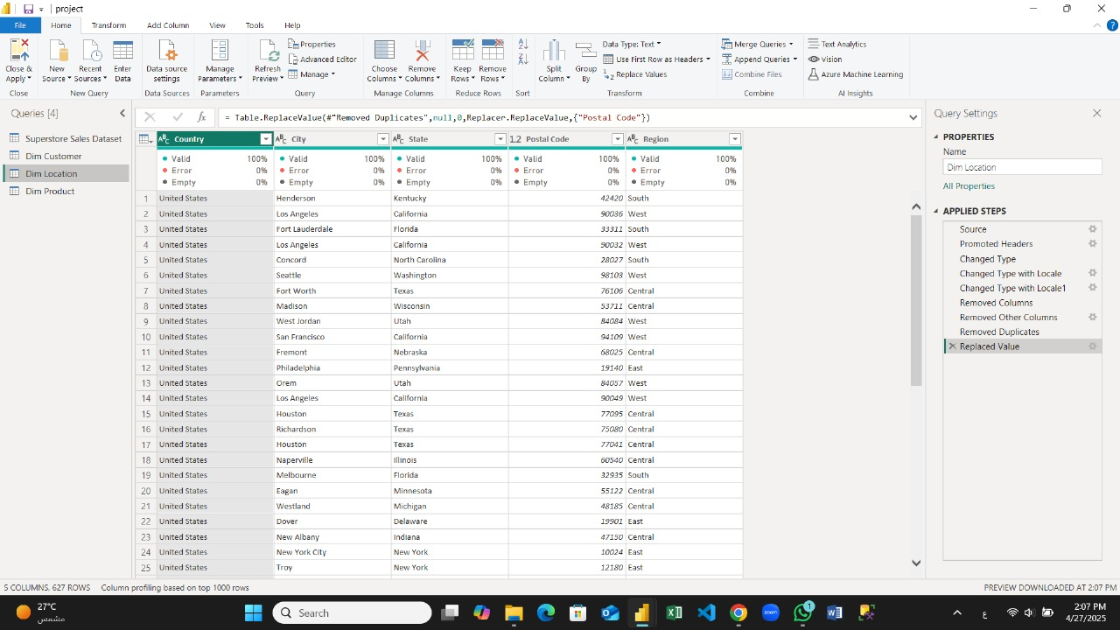
Extract – Transform - Load

Slide 11
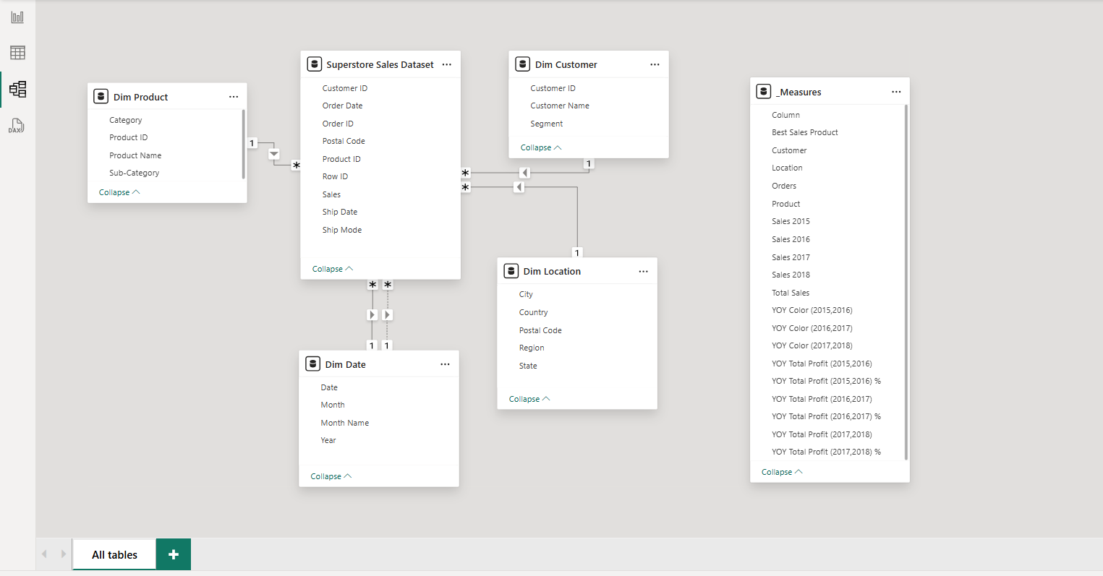
Mapping

Slide 12
Measures
📌 Best Sales Product
🧮 DAX Formula:
Best Sales Product = CALCULATE([Total Sales], 'Dim Product'[Sub-Category] = "Phones")
🎯 Function: It helps analyze how much revenue is being generated specifically by phones, even when viewing overall sales in reports or visualizations.
Using DISTINCTCOUNT
📌 for customers to tells us how many distinct customers are represented in the dataset ,
📌 for Location to tell us how many different postal regions the sales come from — essentially a geographic spread indicator,
📌 for products; to tells us how many different products are part of the sales transactions.

Slide 13
📌 Orders
🧮 DAX Formula:
Orders = COUNT('Superstore Sales Dataset'[Order ID])🔍
🎯 Function
Shows the total number of orders placed
Sales 2015,2016,2017,2018
🧮 DAX Formula:
Sales 2015 = CALCULATE([Total Sales], 'Dim Date'[Year] = 2015)
Sales 2016 = CALCULATE([Total Sales], 'Dim Date'[Year] = 2016)
Sales 2017 = CALCULATE([Total Sales], 'Dim Date'[Year] = 2017)
Sales 2018 = CALCULATE([Total Sales], 'Dim Date'[Year] = 2018)
🎯 Function:
Returns the total sales figure for the year 2015,2016,2017,2018

Slide 14
📌 Total Sales
🧮 DAX Formula
Total Sales = SUM('Superstore Sales Dataset'[Sales])
🎯 Function: it shows the total sales
📌 YOY color (2015,2016) (2016,2017) (2017,2018)
🧮 DAX Formula
YOY Color (2015,2016) = IF([YOY Total Profit (2015,2016) %]>0,"#00B050","Red")
YOY Color (2016,2017) = IF([YOY Total Profit (2016,2017) %]>0,"#00B050","red")
YOY Color (2017,2018) = IF([YOY Total Profit (2017,2018) %]>0,"#00B050","red")
🎯 Function: it shows the Year-Over-Year (YOY) total profit percentage for the years. And the percentage change in profit from 2015 to 2016 for example.

Slide 15
📌YOY Total Profit
🧮 DAX Formula
YOY Total Profit (2015,2016) = [Sales 2016]-[Sales 2015]
YOY Total Profit (2015,2016) % = DIVIDE( ([Sales 2016]-[Sales 2015]),[Sales 2015])
YOY Total Profit (2016,2017) = [Sales 2017]-[Sales 2016]
YOY Total Profit (2016,2017) % = DIVIDE( [Sales 2017]-[Sales 2016] ,[Sales 2016])
YOY Total Profit (2017,2018) = [Sales 2018]-[Sales 2017]
YOY Total Profit (2017,2018) % = DIVIDE([Sales 2018]-[Sales 2017],[Sales 2017])
🎯 Function:
It shows the change in profit between two consecutive years (2015 and 2016). It identifies growth trends or declines in sales over the year.

Slide 16

Dashboards
cover

Slide 17
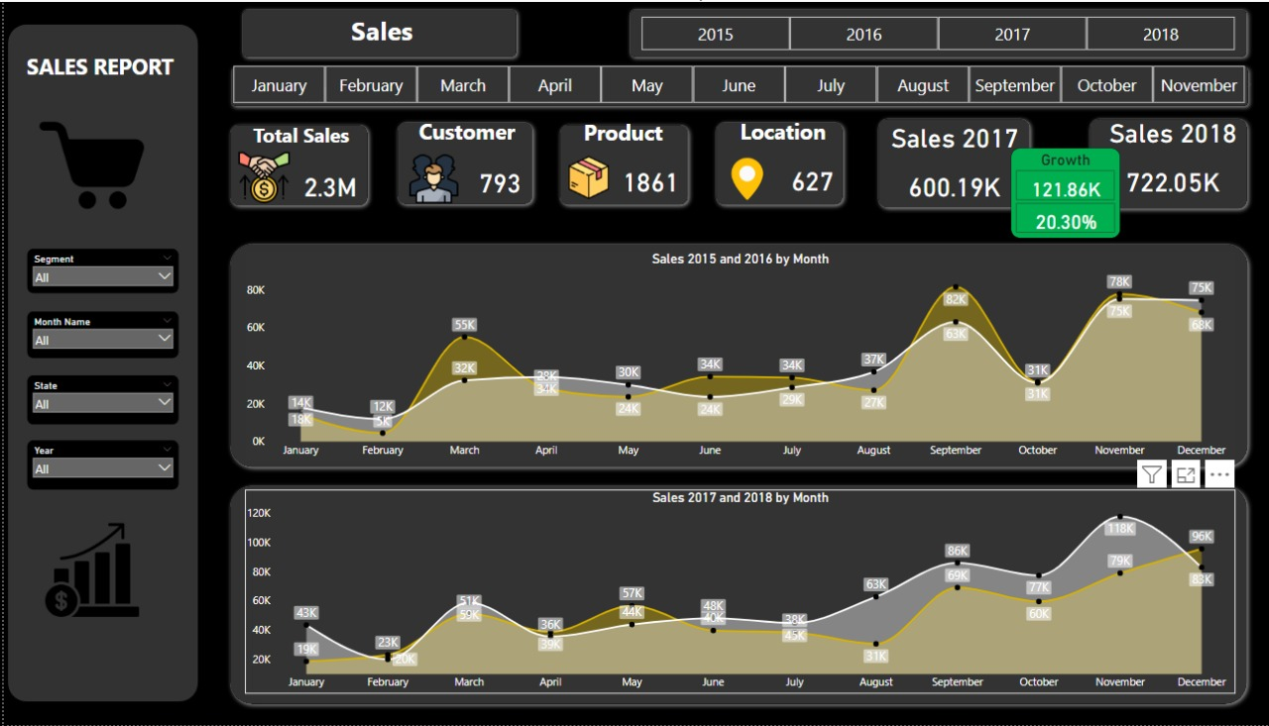
Sales

Slide 18
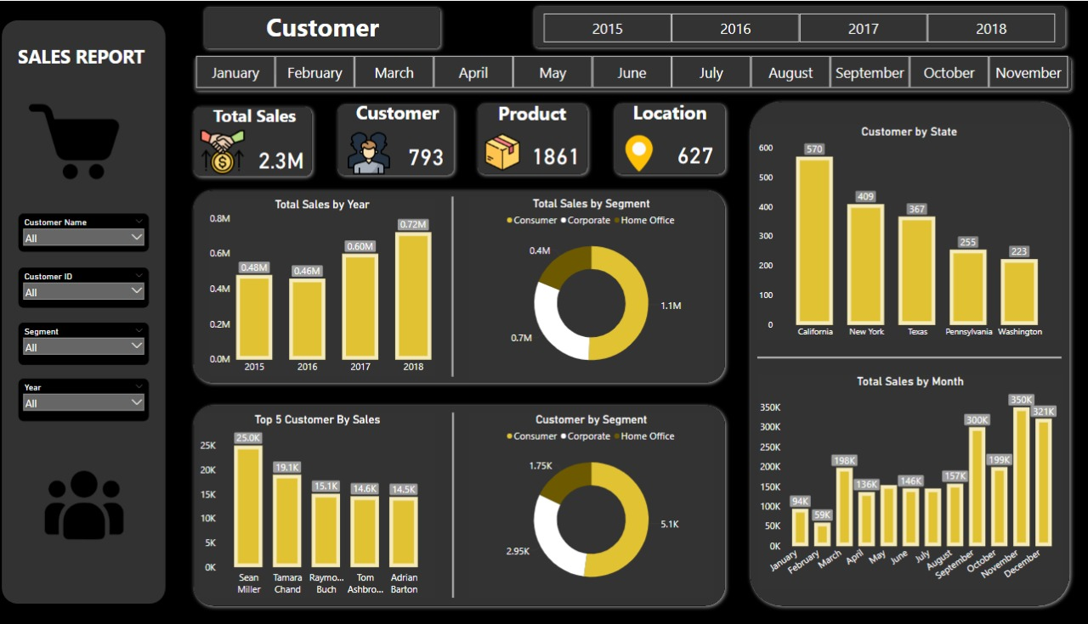
Customer

Slide 19
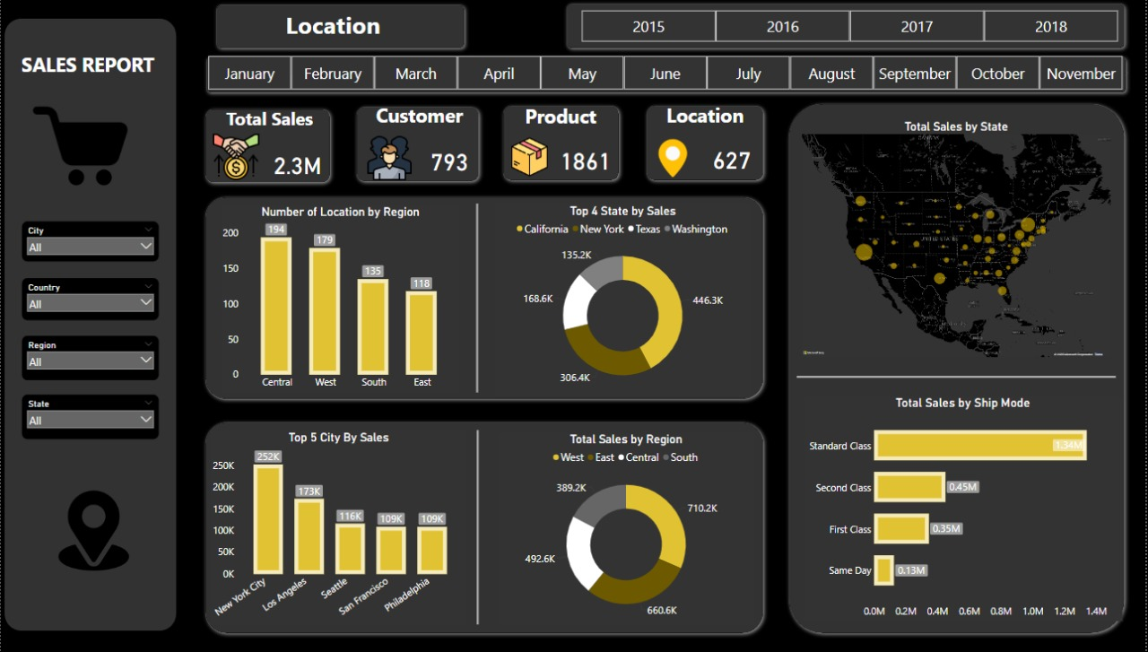
Location

Slide 20
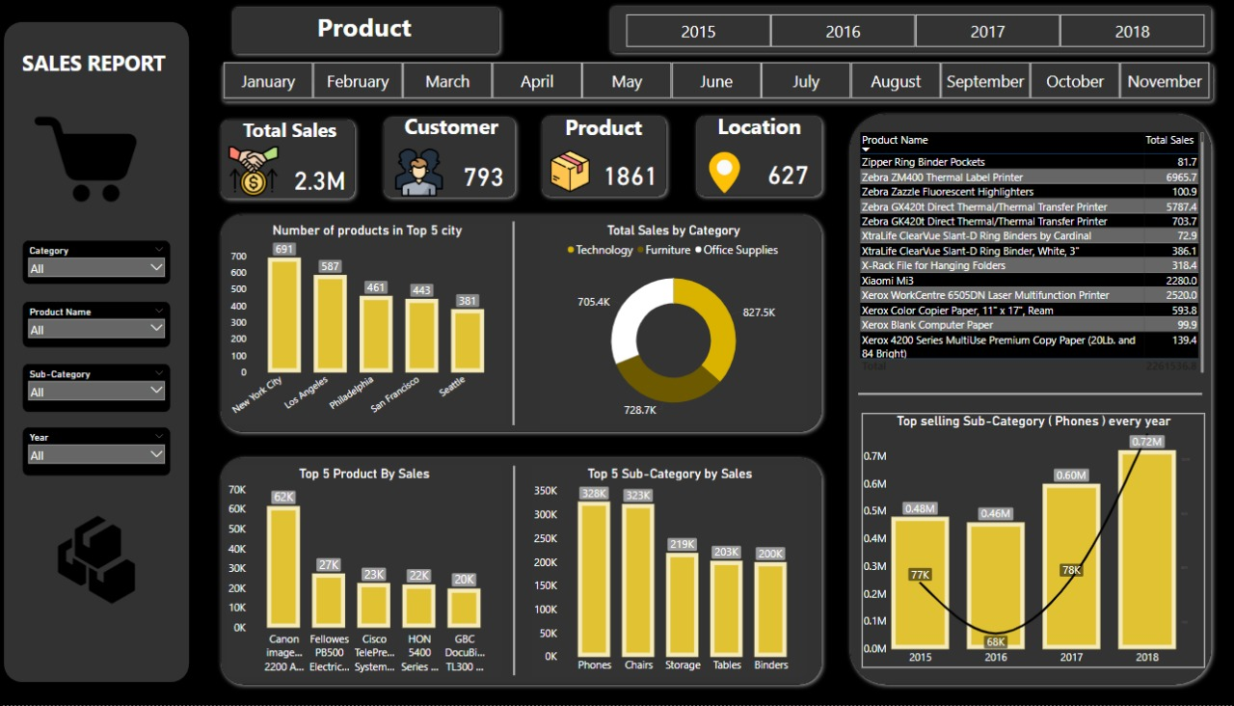
Product

Slide 21
Conclusion & Recommendations
Focus marketing efforts on Q4 to increase seasonal demand
Expand product lines similar to Category A to boost sales volume.
Provide tailored marketing to keep valuable clients.
Start regional initiatives to improve lagging regions.
Review KPIs every month and make proactive strategy adjustments.

